Slide 1
AMIT Graduation Project Presented by : Abdallah Maher Ismayil Emb Oct22

Slide 2
PWM Drawer
❑ PWM Drawer using Graphical LCD and ATmega32.
❑ The generated wave came from external sources (Pulse generator).

Slide 3
• Specification
❑ With the graphical LCD we can display the following:
• The shape of the generated PWM from externally sources.
• The frequency in KHz of the generated wave .
• The duty cycle of the generated wave .
• The time of the single cycle.

Slide 4
1. Flowchart

Slide 5
Initialization
Measure_Signal
Draw_Signal

Slide 6
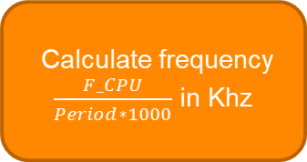
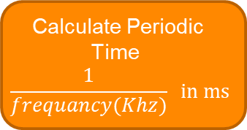

Calculate frequency
$\frac{F_CPU}{Period∗1000}$ in Khz
Clear ICF (Input Capture flag) flag
Set Trigger Edge: Rising Edge
Measure_Signal
Take value of capture register
Start cycle
Clear ICF flag
Set Trigger Edge: Falling Edge
Calculate Duty Cycle
$\frac{High}{Period}x 100$ %
Take value of capture register
High
Clear ICF (Input Capture flag) flag
Set Trigger Edge: Rising Edge
Calculate Periodic Time
$$\frac{1}{frequancy(Khz)} in ms$$
Take value of capture register
Low
Stop the timer

Slide 7
2. SIMULATION

Slide 8
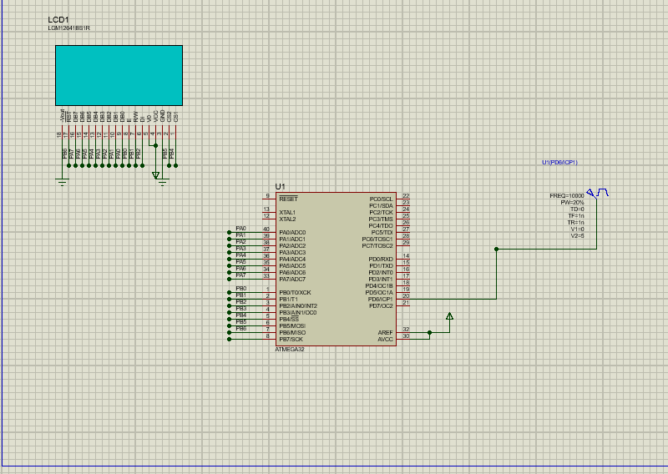
GLCD
Pulse Generator
Atmega32

Slide 9
3. PROTOTYPES

Slide 10
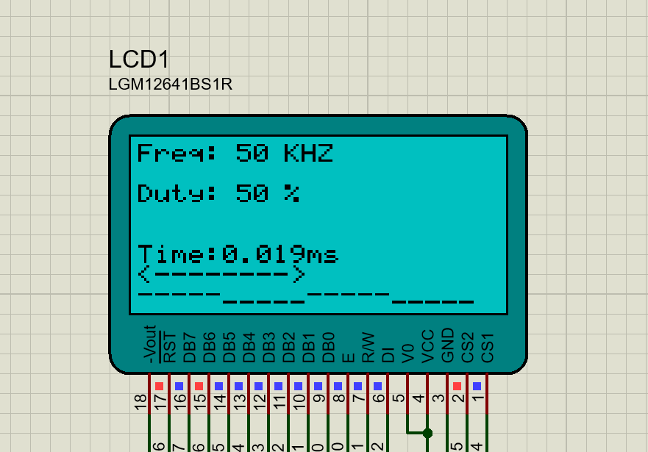
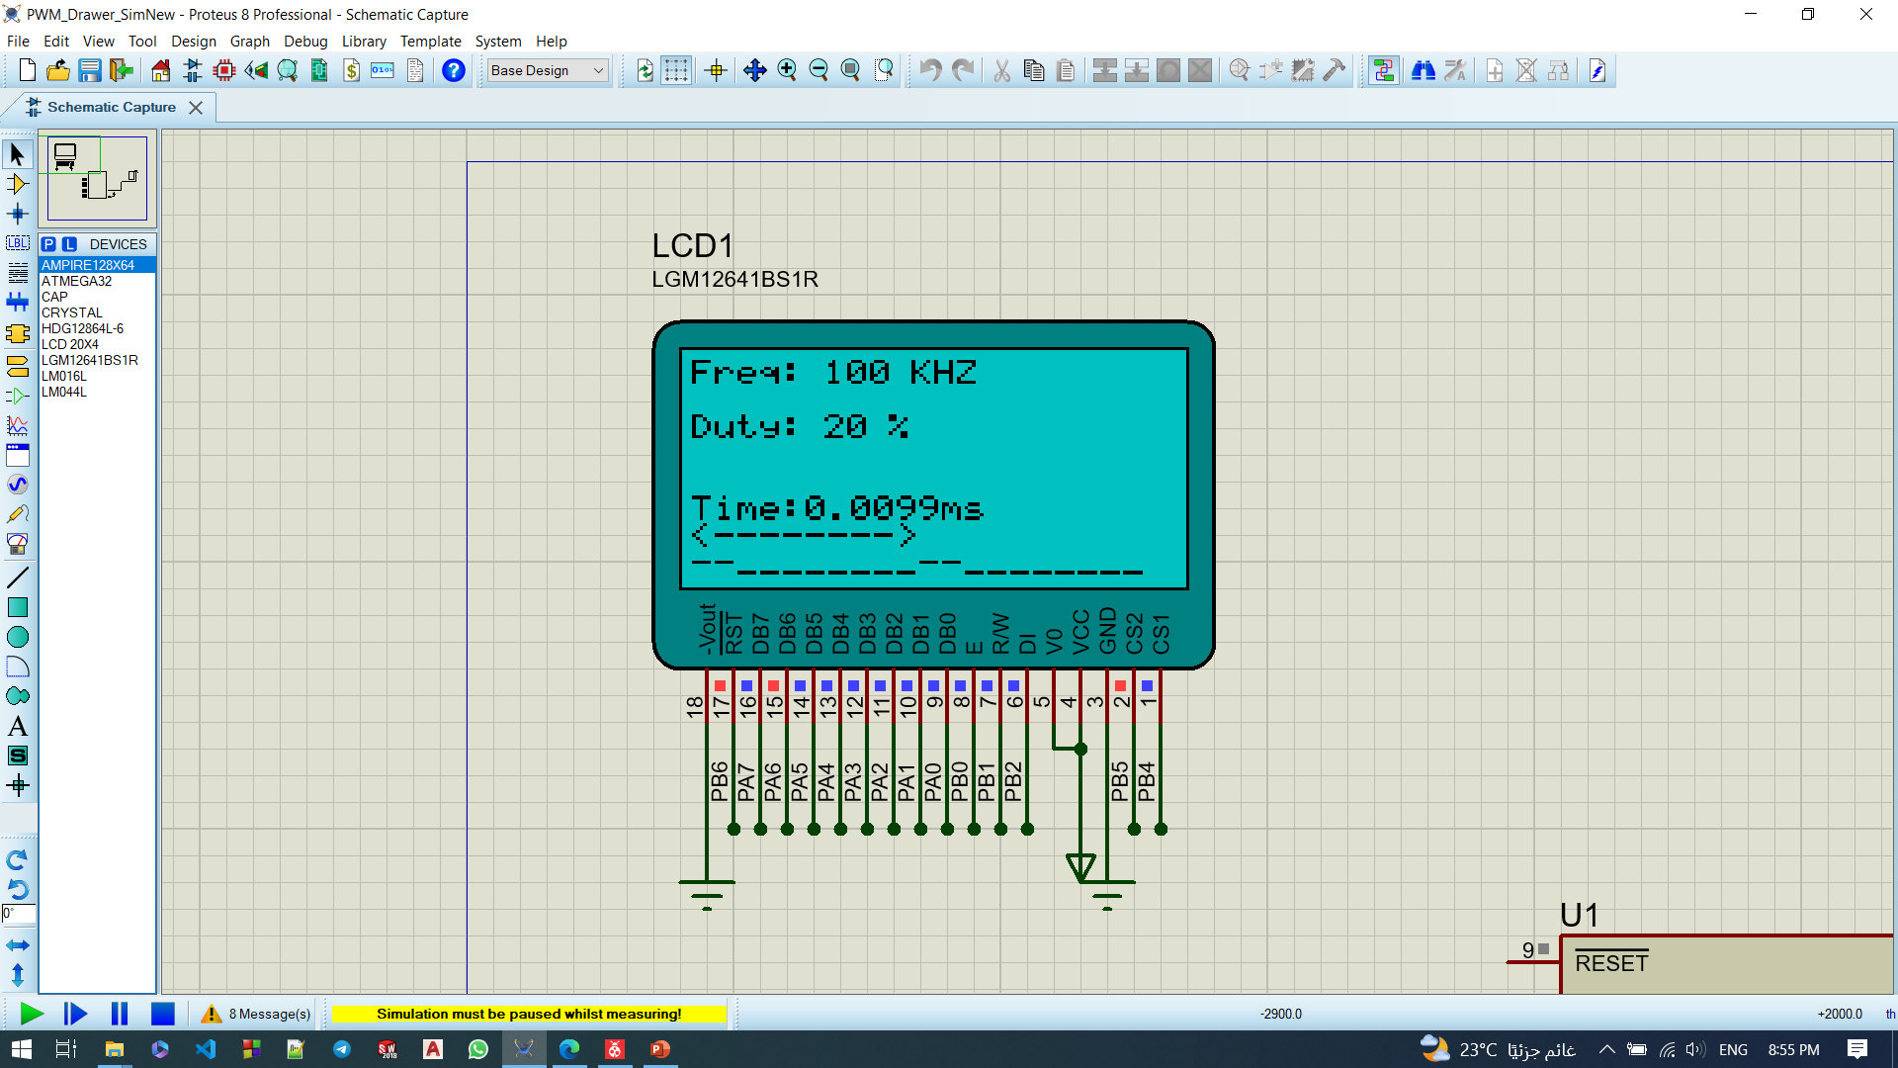
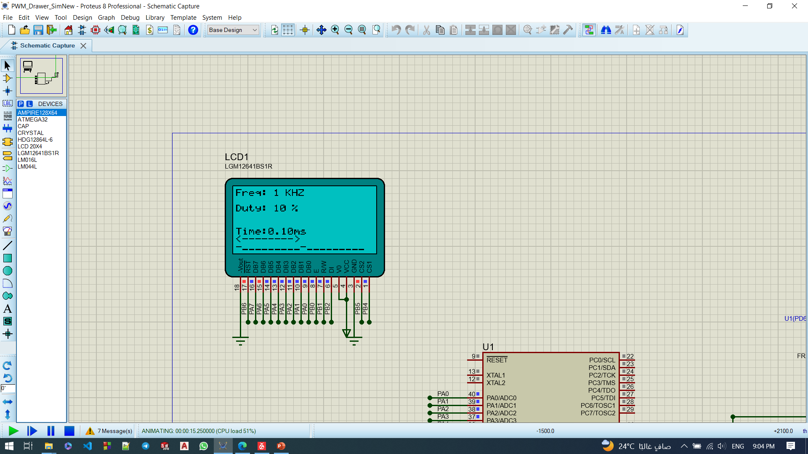
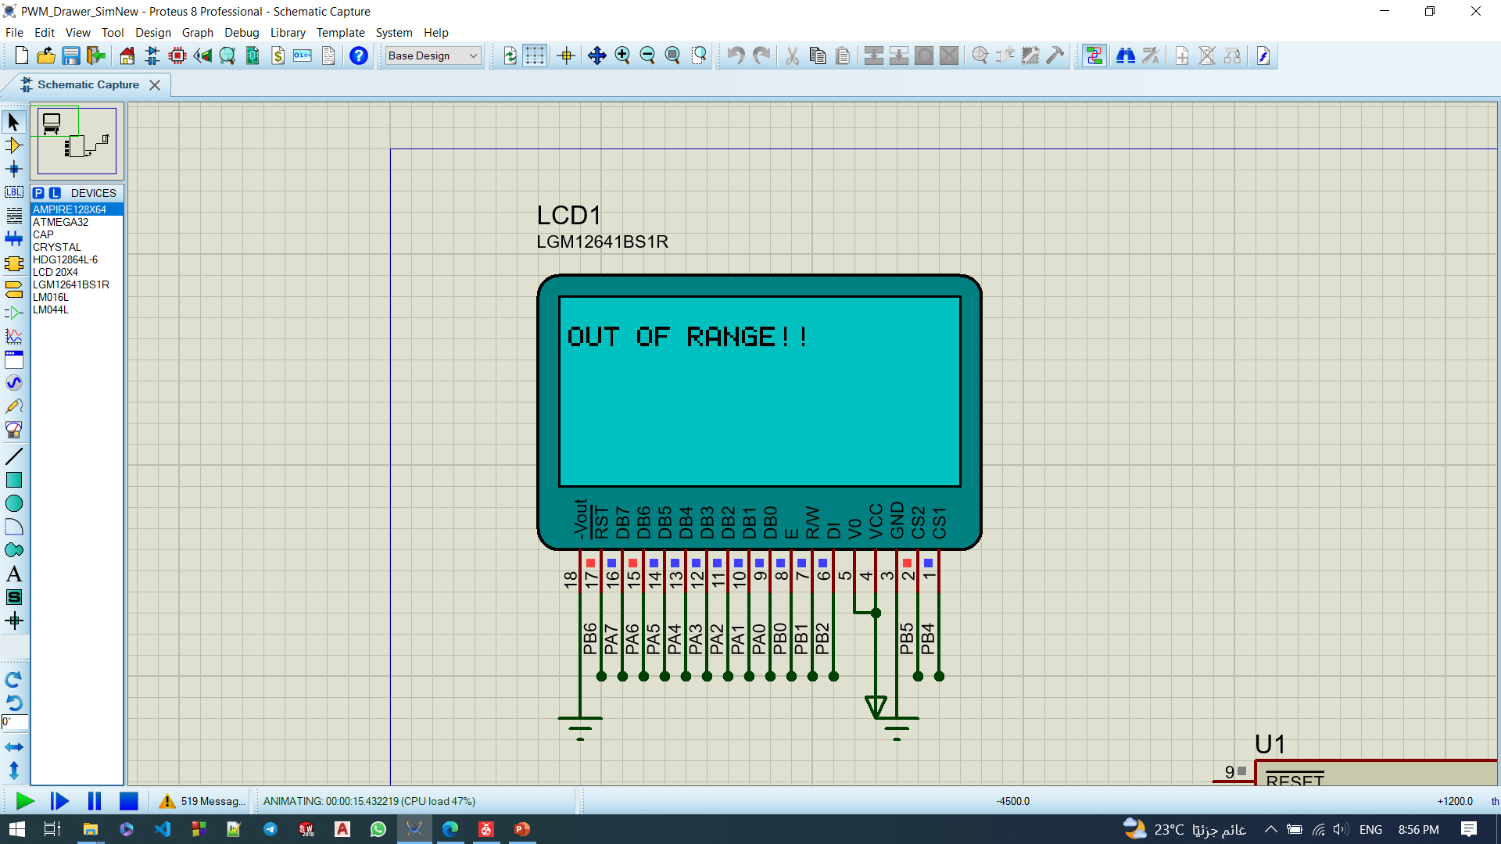

Slide 11
THANK YOU

